Slide 1


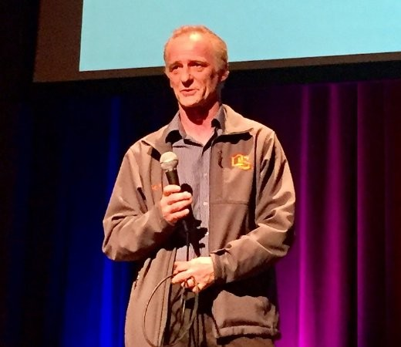
ML in Production
Andrew Ferlitsch
Google Cloud AI / Developer Relations
@andrewferlitsch
Code, Notebooks: https://github.com/GoogleCloudPlatform/keras-idiomatic-programmer

Slide 2
Timeline
01

Slide 3

Timeline - Roles/Jobs
2017
2018
2019
2020
Planning /
Discovery
Exploration /
Prototyping
Development / Transition
Production
Full Production
10K Data Scientists
250K Data Scientists
2M ML practitioners
Decision Makers
Eng Staff
ML Consultants
Sr. Eng Mgr
Sr. Data Scientist Lead Data Engineer DB Team ML Consultants
CTO Sr. Data Scientist Lead Jr. Data Scientists
Data Engineers(s) ML Ops ML API Services ISVs
CTO / COO / Executive(s) Sr. Data Scientist Lead Jr. Data Scientists
Data Engineers(s) ML Ops ML/AI managed services
ML/AI Turnkey solutions ISVs
AI/ML on everyone’s radar
Peak of Gartner’s Hype curve
Everyone is full in

Slide 4
Timeline - Technology
2017
2018
2019
2020
Planning /
Discovery
Exploration /
Prototyping
Development / Transition
Production
Full Production
Business Intelligence + ML Scilearn, NLTK
CART Analysis
Statistics Background
Deep Learning Tensorflow / Pytorch
Transfer Learning ML APIs ML managed training services
Stats / CS / Data backgrounds
Deep Learning / RL Meta-Learning Builtin ML Algorithms
Hyperparameter Search
Macro-Architecture Search ML/AI managed e2e services ML/AI turnkey solutions
CS / AI / Data / Ops backgrounds
Data Validation
Meta-Learning Explosion ??

Slide 5

(2020) Job Definitions
Innovation Centers
Production
Machine Learning
Operations
Applied Data Scientists (Senior)
Research Data Scientists
AI Application Engineers
Machine Learning Engineers
Data Engineers
QA
Not well defined how QA fits in.

Slide 6











2019 Production Flow
Data Repo
Data Labelling
Validation
Data Distribution
Model Training
Versioning
Deploy
A/B Testing
Trained Model Repo
Model Instances
Warmup Instances

Slide 7
It’s Not Just a Model Anymore!
02

Slide 8
Model vs. Application
We don’t talk anymore about a “single model”, or a collection of independent models.
We now build applications as composition (amalgamation) of models and AI services (APIs, Turnkey solutions).
Models are becoming more:
Multi-Task
Self (Meta) Learning
Common Layers
Connecting via Embeddings

Slide 9
Macro Architecture for Classifier
Image Data
Macro-Architecture (e.g., CNN)
Embedding (final feature maps flatten after bottleneck layer)
Learner
Conv Group
Conv Group
Conv
Group
Stem
Classifier
Pre-Stem Group
Stem Convolution Group
...
Classifier Group
Learned Feature Maps
Transfer Learning uses existing embeddings and retrains a new classifier.

Slide 10
Example: Multi-Task Model (OD)
Faster R-CNN Macro-Architecture
Pretrained Convolutional Neural Network (Reuse)
Conv
Net
Region
Proposal
Network
(RPN)
Region of Interest (RoI) Pooling
Classifier
Stem Convolution Group
Two models are learned in parallel using shared layers
Bounding Box Regresser
Shared Feature Maps
Location (Bounding Box) Learning
‹#›
Feature & Classification Learning

Slide 11
Example: Sports Broadcasting
What is in the frame
Who(m) is(are) the player(s)
Face Recognition (Player)
Pose Estimation
Shared Conv Net
Object Detection
Live Video
Object Level Embeddings
Market Specific
Language
Dense Embedding
What is happening
Predictive Action (non-RNN)
Image Captioning
Translation (Market)
Text-to-Speech
Closed Caption

Slide 12

Example: Power Transmission Lines
Video Stream
Object
Detection
MultiClass Classifier
Condition
(Auto) Labeled Data
Line Impedance Sensors
Anomaly
Detection
Maintenance

Slide 13
Example: Home Vision Analysis
Interior
MultiClass
Classifier
Market Appeal
Demographic
Binary Classifier
Regressor
Valuation
Sell, Rent
Regressor
Renovation
Repairs
Exterior

Slide 14
Example: Home Vision Analysis
MultiClass Classifier
Condition
Two-Tier: Coarse (e.g. room type)
Detail (e.g., items in room)
Embedding Crops
Object
Detection
Amenities
MultiClass
Classifier
Market Appeal
Dense Embeddings
Embedding
MultiClass Classifier
Regressor
Condition
Valuation

Slide 15
Developments in Commercial AutoML
03

Slide 16
AutoML Today
AutoML has came along ways since Google’s paper on Nasnet
Levels of Service.
Transfer Learning (Builtin Algorithms)
Hyperparameter Search
Macro-Architecture Search (MobileNet V3)
Micro-Architecture Search (NasNet, EfficientNet)
[Research] Data Validation
* not covered

Slide 17
Builtin Algorithms - Transfer Learning
Reconfigurable Pre-Built Model Architecture
Stem Convolutional Group
Input Shape (e.g., (None, None, 3))
Conv Group(s)
Final Pooling Flatten Layer
Optional (pooling=None) If not included, then the activation layer for the final convolution is the bottleneck layer.
Convolutions
No Classifier
Model Architecture Specific Convolutional Groups
Final layer before classifier, also called the Bottleneck Layer (Embedding)

Slide 18



Hyperparameter Search
The Big Three
Learning Rate (Scheduler)
Batch Size
Regularization

Slide 19
Hyperparameter Search
Learning Rate Scheduler
Warmup weight initialization using very small learning rate on ensemble of models.
Select model instance with best numerical stability (lottery principle).
Learn the optimal learning rate schedule
Model instance with the selected weight initialization.
Model instance with the selected weight initialization.
Full training with the learned learning rate schedule.
Warmup
Pre-Training
Model Training
Model Instances
Model Instances
Model Instances
Model Training
Model Training
Model Training

Slide 20
Hyperparameter Search
Batch Size
Progressively increase batch size later in training adds numerical stability for convergence.
Large batch sizes act as smoothing factor (an implicit form of regularization), resulting in less need of regularization.
Dynamic change in model regularization requires dynamic graph.
Training
Progressively decrease model regularization as batch size increases.

Slide 21
Hyperparameter Search
Regularization
Value learned during pre-training.
Conv Group
Conv Group
Conv
Group
Dropout
Label Smoothing
Stem Convolution Group
...
Classifier Group
Noise
Initial value learned during pre-training.
Stepwise reduced as batch size increases.
Layer Regularization, Batch Normalization

Slide 22
Hyperparameter Search
Macro-Architecture Search
Meta-Parameters - These are the parameters for configuring macro-architecture.
Hyper-parameters - These are the parameters for training the model.
Parameters - These are the parameters the model will learn during training.

Slide 23
Hyperparameter Search
Macro-Architecture Search
Metaparameters: Number of convolutional groups (depth), number of output filters (width), and type of convolutional group (e.g., resnet v2).
Conv Group
Type
Conv Group
Type
Conv
Group
Type
...
Learner

Slide 24
Data Engineering
04

Slide 25
Moving Preprocessing into Graph
Implement preprocessing as graph operations (e.g., AutoGraph) in plug-n-play pre-stem modules:
Crop / Padding
Resizing
Normalization
Can use tf.keras Functional API to extend existing model to add data preprocessing pipeline to existing model
Model
Stem
Pre-Stem Group
Stem Convolution Group
Converting “Raw Data” into “Machine Learning Ready Data” inside the model.

Slide 26
Translational Invariance
Image Augmentation
Input
Feature
Maps
Concat
Convolutions
Identity Link with translational invariance steps
Image Augmentation for translational invariance moving into the graph.
Random Crop
Upsampling
Random Flip
Random Rotate

Slide 27
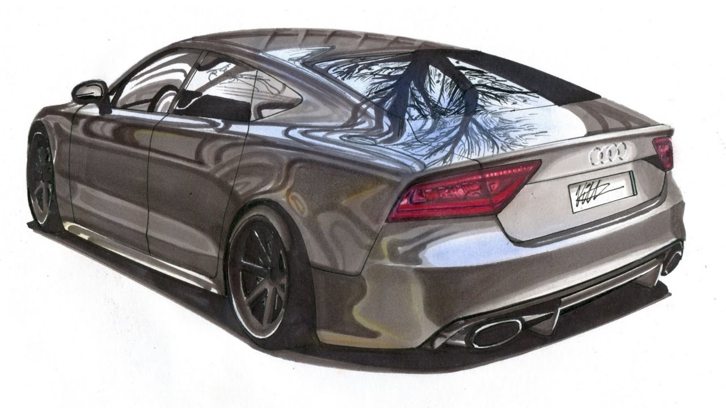

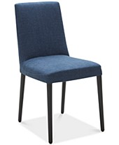
Learning Essential Features
We stopped learning data -- we now learn “essential features”
Synthetic Data (prebuilt datasets or generators, i.e., Unity)
Occlusion (overlaying objects on “item being classified”)
Optical Flow (overlaying objects in the background, i.,e., Flying Chairs)

Slide 28
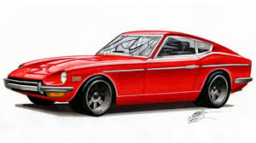
Learning Essential Features
Pre-train with Synthetic Data
Synthetic Data
Model Training
Embedding
Learn embedding for essential features.
Pre-training
Real-World Data
Full-Training
Fine-Tuning

Slide 29
Learning Essential Features
Train with Occlusion
Overlay natural objects for scene that obscures part of the object being recognized.
Occlusion Objects
Model Training
Embedding
Learn embedding for essential features.
Real-World Data
Full-Training

Slide 30
Learning Essential Features
Train with Optical Flow
Overlay non-natural objects for scene in the background.
Optical Objects
Model Training
Embedding
Aids in filtering background features.
Real-World Data
Full-Training

Slide 31
Meta-Learning
05

Slide 32

Meta-Learning
Knowledge Distillation
(un) Labeled Data
Semi-Supervised Learning
(noisy) Labeled Data
Weakly-Supervised Learning

Slide 33
Knowledge Distillation
Use Large Models to Train Compact (e.g., Mobile) Models
Pre-trained Large Model (Teacher)
Softmax
Class probability distribution (soft labels).
The loss between the teacher’s soft labels and student, along with hard labels, is backward propagated.
Training Data
Loss Function
Compact Model (Student)
Softmax
Predictive probability distribution
Compact Model being Trained to Mimic Large Model

Slide 34
Semi-Supervised Learning
Model trained on Label Data
The Pseudo Labeled data and Labeled data are merged into new training set.
Unlabeled Data
Pseudo labeled Data
Composite
Training Data
Labeled Data
Model has good accuracy to start with.

Slide 35
Semi-Supervised Learning
Composite
Training Data
Next Composite
Training Data
Continued Training of Model
After each epoch, the refined pseudo labeled data is recombined with label data for a new (better) composite training set.
Pseudo labeled Data
Mini-batches are drawn with mix of labeled and pseudo labeled data.
Batches smooth out the error, and the error acts as a regularizer.
Labeled Data
Continuously repeat. The next composite training set is feed for training.

Slide 36
Weakly-Supervised Learning
Ensemble in Training
Noisy Data
1) An ensemble set of models are trained on noisy labeled data.
Weak Learner
Source is generally from crowd sourced data.
Weak Learner
Labeled Data
2) The ensemble set of models is fine-tuned on good label data.
Good Label data.
Weak Learner

Slide 37
Weakly-Supervised Learning
The weakly trained ensemble is used to generate “less noisy” labels.
Weakly Trained Ensemble
Train a strong model with combined good label data and less noisy labeled data.
Weak Learner
Noisy Data
Less Noisy Data
Weak Learner
Strong Model
Weak Learner
The noisy data is feed thru the ensemble in predictive mode.
Labeled Data

Slide 38
Ethical AI
06

Slide 39
Bias
(SME) Identify which classes are demographically imbalanced.
Resampling rules are added to adjust for imbalance.
Imbalanced Dataset
Model Training
Resampling
Mini
Batches
Examples from imbalanced classes may appear more than once per epoch (boosting)
Bias is caused when the dataset is imbalanced to the “real-world” population that the model will see when deployed.

Slide 40
Fairness
(SME) Identify which features have culturally discrimination.
Add rules for generating synthetic examples from existing examples by reducing collinearity between discriminating features.
Removing cultural features (gender, race, age, …) does not work due to the fact that other features have collinearity with them (they predict each other).
Example: Where gender and income features would be discriminatory. Generate new examples by randomly flipping the gender.
Discriminatory Dataset
Non-Discriminatory Dataset
Synthetic Generator
Non-Fairness is caused when prior cultural discrimination is represented in the dataset.

Slide 41
Explainable AI
Society won’t trust Models whose predictions can’t be explained, audited and justified.
Heat Map
Black Box Model
Instrumented Model
Instrument
Embed instrumentation into the model layers (profiling.
Make Prediction
How strong did each feature contribute to the prediction.

Slide 42
Explainable AI
Heat Map
If a person’s income was X more, it would have flipped the decision.
Instrumented Model
If a person’s credit score was Y more, it would have flipped the decision.
Make Prediction
Detect data points in features that where near edge of linear separation.

